Slide 1
Style My Space 3D
Padhiyar Tejas
Bhadke Mansi
Shete Nikita
Patni Harsh

Slide 2
Introduction of App
Did you know that modern technology can influence the home design area immensely?
Augmented Reality (AR) is one of the biggest technology trends, combining a real-world environment with computer-generated input.
The Interior designing app is based on AR technology.

Slide 3

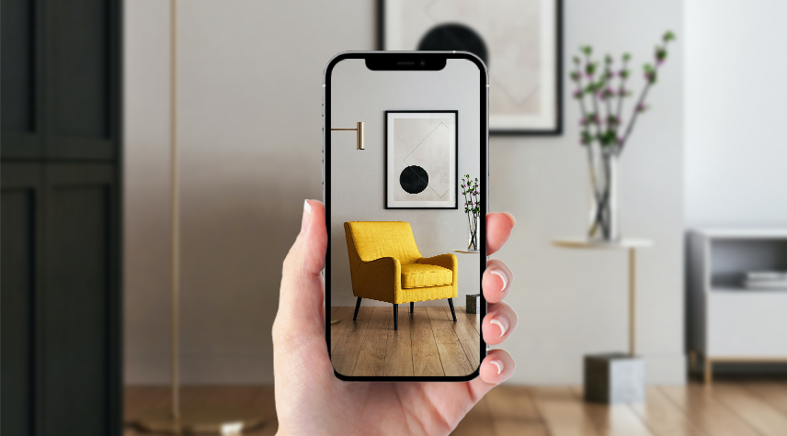
Augmented Reality
Augmented Reality (AR) is one of the biggest technology trends, combining a real-world environment with computer-generated input.

Slide 4
Need
For interior designers and architect, so their work possibly is less i.e. they don’t need to create the model again and again, and wait for approval from customer.
Better Visualization while customizing the room, user or customer gets clear idea and view of the objects.

Slide 5
Resources Used
XCode – it is the software that is used to build app for Apple devices. It is developed by Apple. It is more or less similar to Android Studio.
Swift – it is the language developed by Apple. It works only on Apple devices. It was first released in June 2,2014. It’s latest stable version is 5.4.1, after that it is called SwiftUI.
.USDZ 3D model – 3D model with this extension i.e. .usdz are used in this app.

Slide 6
Limitations
It is available only on iPhone and iPad.
As it is developed in Swift language which works only on Apple devices.

Slide 7
Advantages
This helps the client visualize the project before it is developed. It gives an ability to user to design the space the way they want.
User will also get an ability to edit the design and make changes even if the design is at the final stage. So, now users need not worry about the tedious corrections that done in actual decor and furniture.
AR in system will let user guide the designer in the best possible manner Even the minute details related to the designing process can be communicated interactively.
The client can try various products for their new project such as the furniture without paying a penny.
Using this system, it would be much easier for designer to present their innovative ideas to client.
The designers can gain a competitive edge by giving their clients a complete view and information about their future project.

Slide 8
Disadvantages
It is quite expensive to use AR based system and maintain it. Moreover, it is costly to use it in daily life.
For designing using system requires training and specific tools to be made available to designers.
One major drawback of AR based application is lack of privacy.

Slide 9
Future Scope
The interior design market is expected to see an exponential growth by 2025 globally.
The global interior design software market was valued at USD 3,829 million in 2019, and it is expected to reach a value of USD 6,433.9 million by 2025, registering a CAGR of 9.07% over the forecast period 2020-2025.
In future versions, the whole site construction can be visualized with our software.

Slide 10
Conclusion
A new age customer wants a customized or personalized solution exactly according to their needs.
The time of designers will be saved. Also, it will be easy for the designer to clear the idea to the client.
The designers can gain a competitive edge by giving their clients a complete view and information about their future project.

Slide 11
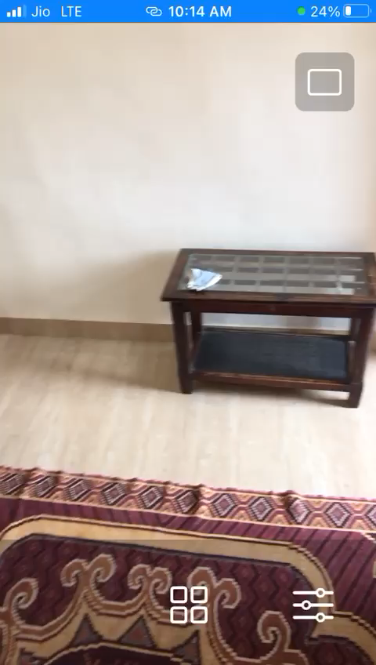

Slide 12
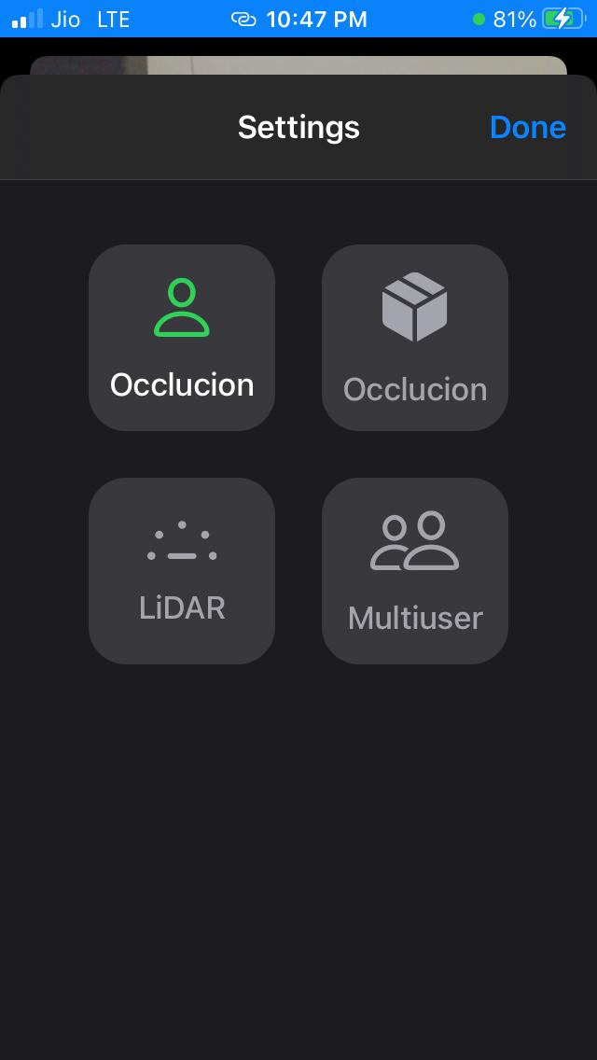

Slide 13
Thank You !

